Slide 1
Superlatives
Суперлатив кај придавките

Slide 2
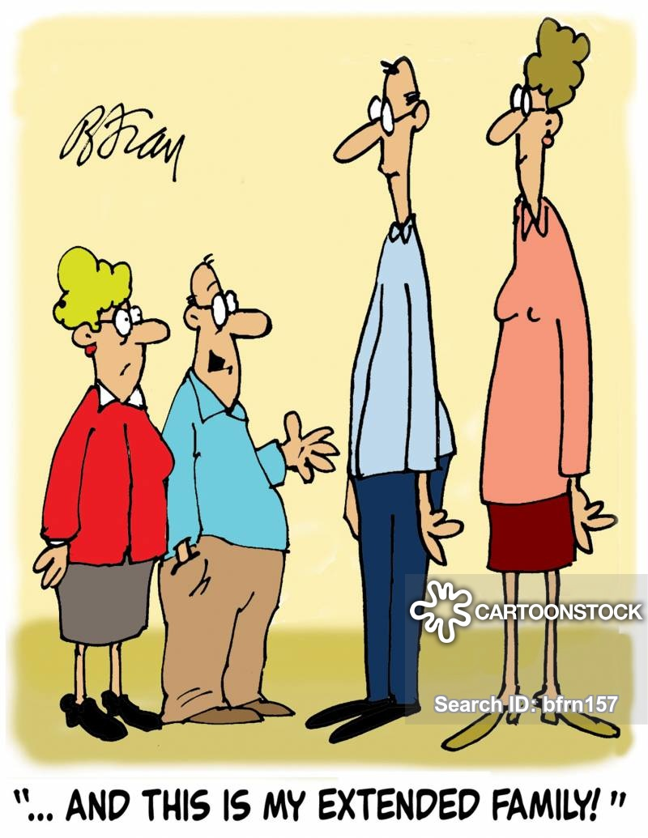
Употреба:
Superlative adjectives are used to describe an object which is at the upper or lower limit of a quality (the tallest, the smallest, the fastest, the highest). They are used in sentences where a subject is compared to a group of objects.
We use superlative form to say which thing is top in a group.

Slide 3
How do we form superlative?
Noun (subject) + verb + the + superlative adjective + noun (object).
EXAMPLES
My house is the largest one in our neighborhood.
This is the smallest box I've ever seen.
Your dog ran the fastest of any dog in the race.

Slide 4
Граматичко правило за формирање суперлатив кај придавките
Add ‘and ‘-iest’ for two syllable adjectives which end in ‘y’ (and take away the ‘y’).
Use ‘more’ and ‘the most’ with other two syllable (or more) adjectives.
one syllable: small – smaller – the smallest
two syllables with ‘y’: happy – happier – the happiest
two+ syllables: beautiful – more beautiful – the most beautiful

Slide 5
Неправилен суперлатив
The adjectives ‘good’, ‘bad’ and ‘far’ have special forms.
good – the best
bad – the worst
far – the furthest

Slide 6
When speaking
We say... We don’t say...
My father is the tallest in my family.
(NOT My father is the most tall in my family.)
This book is the most interesting book. (NOT This book is the interestingest book.)
Гордана Котевски
Татјана Трајковска

Slide 7
WHAT IS THE SUPERLATIVE FORM OF THE FOLLOWING ADJECTIVES?
Hard
Interesting
Chalenging
High

Slide 8
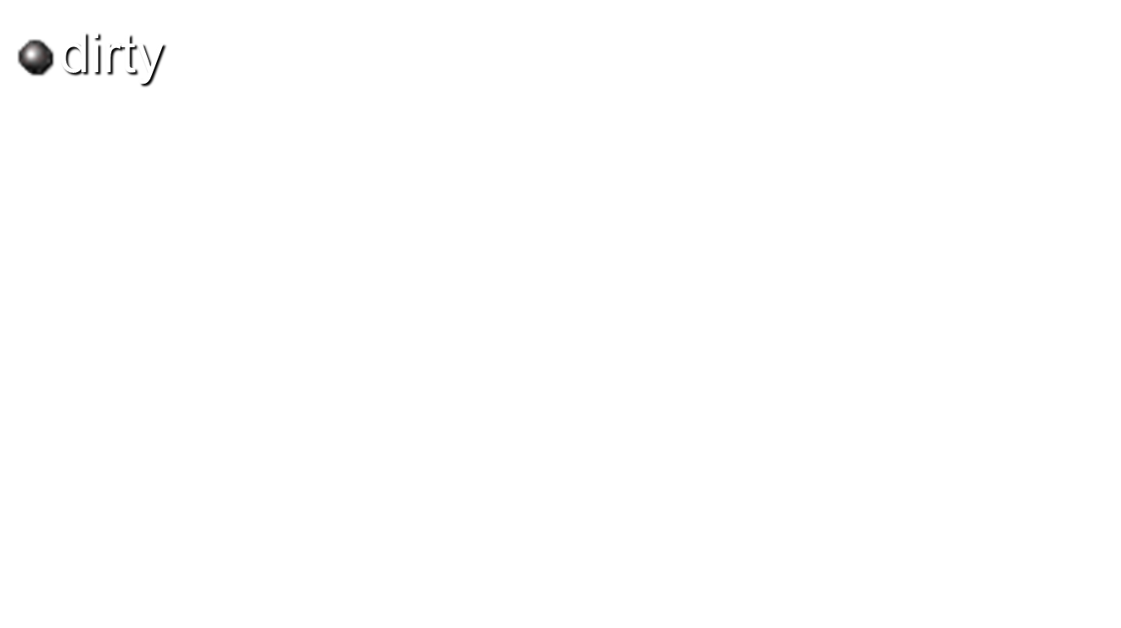
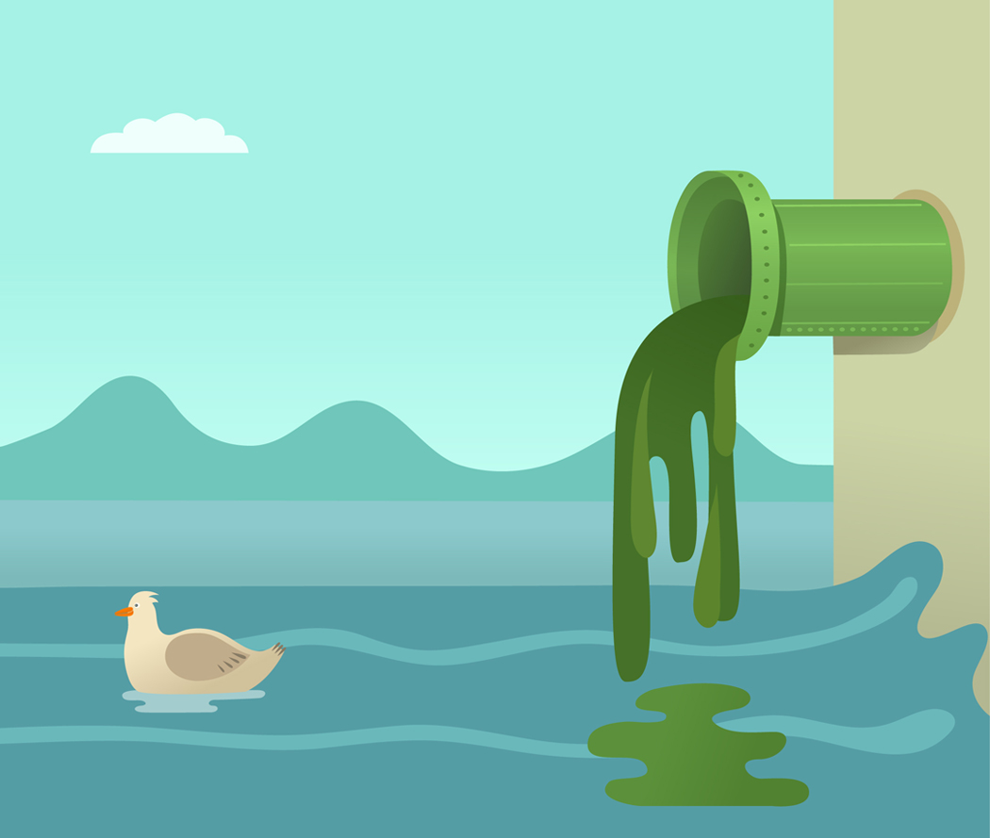

Slide 9

Fair
Handsome
Tall
Smart

Slide 10



