Slide 1
FUTURE
Габриела Мамакис – Петковска
Наставник по англиски јазик
ОУ Стив Наумов - Битола

Slide 2
FUTURE
Will
Present Continuous Tense
Present Simple Tense
Going to

Slide 3
Present Continuous Tense
Form
To be
It is used for:
Definite arrangements
Example :
We are meeting outside the cinema tonight.
Am
Is + verb +-ing
Are

Slide 4
Present Simple Tense
Form
Infinitive of the verb ; 3rd person singular V+s/es ;
It is used for:
Timetabled events
Example :
The museum opens at 10 o’clock.

Slide 5
Going to
Form
To be
It is used for:
Plans and intentions
Example :
They are going to travel to England next summer.
Prediction with evidence
Example :
Look at the clouds! It’s going to rain.
Am
Is + going to + verb
Are

Slide 6
Future Simple – will
Form
Will + verb
It is used for:
Decisions made on the spot
Example :
Someone’s at the door. I will open it.
General predictions
Example :
I think the cars will fly in 2050
promises, warnings, threats, offers and requests
Example :
We will help you with the shopping.

Slide 7
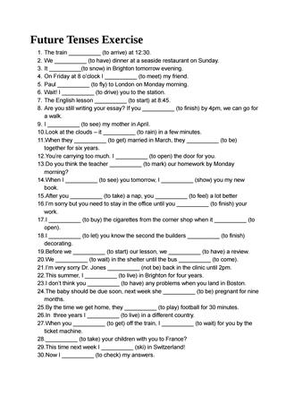
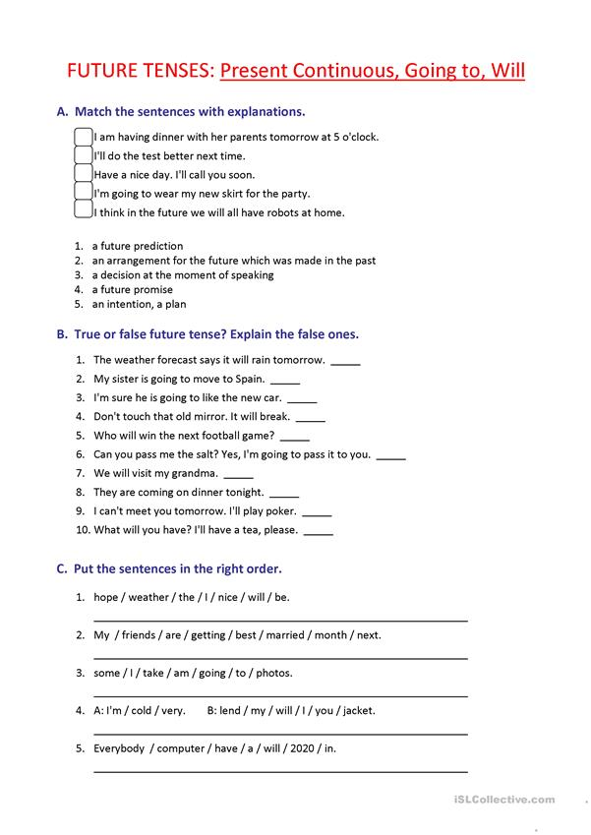

Slide 8
Useful links
https://www.ego4u.com/en/cram-up/grammar/future-1-will
https://www.ego4u.com/en/cram-up/grammar/future-1-going-to
https://www.ego4u.com/en/cram-up/grammar/future-1-progressive
https://agendaweb.org/verbs/future-be-going-to-exercises.html

