Slide 1
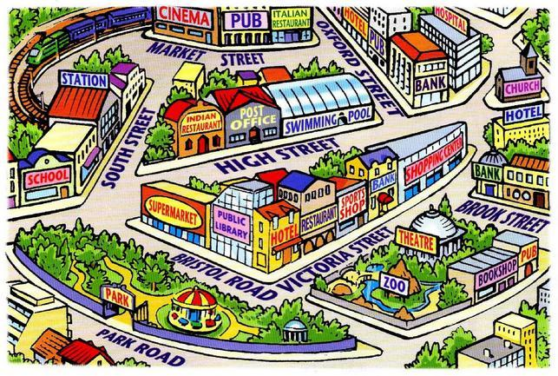
Обработка на лексички единици – Places in town VI одделение

Slide 2
Sports centre - спортски центар

Slide 3
Bowling alley - куглана

Slide 4
Aquarium - аквариум

Slide 5
Internet café – интернет кафуле

Slide 6
Cathedral - катедрала

Slide 7
Shopping centre – трговски центар

Slide 8
Cinema - кино

Slide 9
Bus station – автобуска станица

Slide 10
Museum - музеј

Slide 11
Church - црква

Slide 12
Park - парк

Slide 13
Railway station – железничка станица

Slide 14
ANSWER THE QUESTIONS ☺
1. WHERE CAN YOU BUY JEANS? ----------------------------------------------
2.WHERE CAN YOU PLAY VOLLEYBALL?-------------------------------------
3.WHERE CAN YOU SURF THE NET?--------------------------------------------
4.WHERE CAN YOU FIND A DOLPHIN?---------------------------------------
5.WHERE CAN YOU FIND A VERY OLD VASE?------------------------------
6.WHERE CAN YOU WATCH A FILM?------------------------------------------
7.WHERE CAN YOU TAKE YOUR DOG FOR A WALK?-------------------
8.WHERE CAN YOU CATCH A BUS?--------------------------------------------
WHAT IS YOUR FAVOURITE PLACE? ☺

Slide 15
THANK YOU FOR YOUR ATTENTION! ☺
ПРОВЕРИ ГО СВОЕТО ЗНАЕЊЕ-
https://learnenglishkids.britishcouncil.org/word-games/places-town-1
ПОДГОТВИЛ:
Соња Антуновиќ-наставник по англиски јазик
ОУ”Александар Турунџев”-Кукуречани

