Slide 1
Unit 8 – It’s a crime
ОСМУ „Д-р Јован Калаузи“ – Битола
Подготви Елена Шалевска
- предметен професор по англиски јазик -

Slide 2
Part 1
Vocabulary & Writing

Slide 3
Famous criminals: Al Capone
Al Capone is straight out of central casting when you think mobster, and during the 1920s he became one of the most notorious criminals who ever lived. He ran a violent empire in Chicago known as the Chicago Outfit that dealt in bootlegging, prostitution, and gambling.
Capone was also connected to the bloody St Valentine's Day Massacre, where many members of a rival gang were cut down by machine guns. It was largely due to the rival Irish gang hi-jacking Capone's liquor shipments, and for this he shot up an entire city block.

Slide 4
Famous criminals: Pablo Escobar
Pablo Escobar was known as the "King of Coke" during reign, and he amassed a fortune of over two billion dollars. He is one of the most notorious criminals of all time, and his flagrant attitude has been subject of many movies and television shows.
He ran the The Medellin Cartel, one of the most violent and notorious cartels to ever exist. Escobar murdered anybody that got in his way—cops and children included—and during the 70s and 80s he had a near monopoly in the cocaine smuggling business to America, shipping over 80 percent of the drug smuggled into the country.

Slide 5
Your turn: Write an article about a famous criminal of your choosing
Keep it short: 120-200 words
Use some of the vocabulary/phrases in your books
Send it by Sunday, March 22

Slide 6
Part 2
Grammar

Slide 7
Reported speech: Basic Notions
When do we use reported speech? Sometimes someone says a sentence, for example "I'm going to the cinema tonight". Later, maybe we want to tell someone else what the first person said.
In order to transform a sentence, we need to use a reporting verb such as “say” or “tell” and we need to change the tense of the original sentence.
Usually, when making such transformation, we go “one tense backwards”

Slide 8
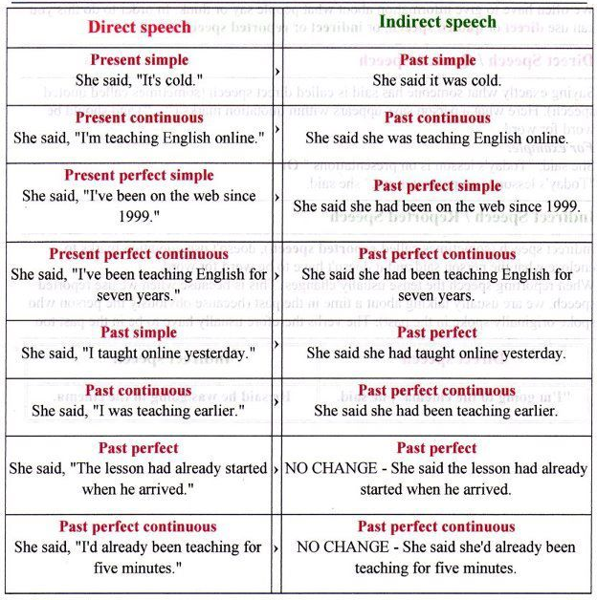
Reported Speech: Tense Change

Slide 9
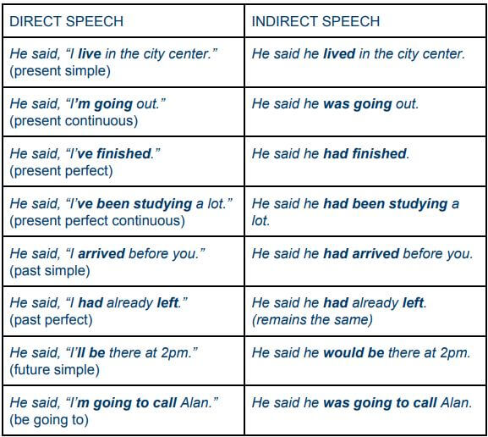
Tense Change Examples

Slide 10
Reported speech: Exercise 1 – Transform the sentences
1. “He works in a bank”
She said ___________________________________________________________
2. “We went out last night”
She told me________________________________________________________
3. “I’m coming!”
She said ___________________________________________________________
4. “I was waiting for the bus when he arrived”
She told me ________________________________________________________
5. “ I’d never been there before”
She said ___________________________________________________________

Slide 11
Reported commands
When we report someone’s commands, we use TO and NOT TO
“Close the door” – She told me TO close the door.
“Don’t eat that” – She told me NOT TO eat that.

Slide 12
Reported questions
Yes/no questions
We use IF for YES/NO QUESTIONS + we change the tense.
“Do you like pesto?” – He asked me IF I liked pesto.
Wh- questions
These questions are made in a similar manner like the regular statements:
“Where is Julie?” – She asked me where Julie was

Slide 13
Still not sure how to use Reported Speech?
Try watching these video-explanations:
https://www.youtube.com/watch?v=lcnVMh0tR9w
https://www.youtube.com/watch?v=BLYjETy1d7s
Need more exercises?
Visit:
https://inglescarmelitaslb.files.wordpress.com/2011/05/reported-speech.pdf

Slide 14
Bonus exercise 1 –
Word formation
The index at the back of the book is in __________ order. (alphabet)
The fans waved __________ as the film star stepped out of the limousine. (excite)
Chickenpox is a highly __________ disease which many people catch as a child. (infect)
Matt is very __________ . He wants to be number one at everything. (compete)
Harry loves cars and he's so __________ about them. (knowledge)
The prime minister thinks there may be a __________ to overthrow him. (conspire)
In __________ with Tokyo, London and Paris are relatively cheap. (compare)

Slide 15
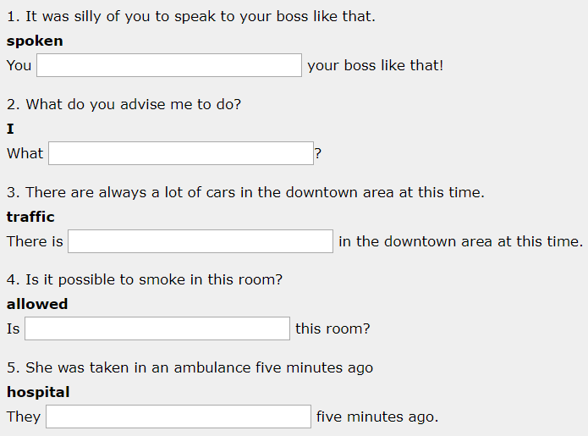
Bonus exercise 2 –
Keyword
Transformations

Slide 16
Do the exercises and most importantly: STAY HOME!
Need movie recommendations? Watch:
Law-abiding citizen
A beautiful mind
The Dreamers
Stonehearst asylum
Fantastic Mr. Fox
Feel like watching a show instead? Try:
Hannibal
Downton Abbey
Scrubs or Brooklyn Nine-Nine
Dark or Mindhunter
In need of a book recommendation? Check these out:
The Perks of Being a Wallflower
A Court of Thorns and Roses
And then there were none
Sharp Objects or Gone Girl

