Slide 1
Unit 8 – Time to spare
ОСМУ „Д-р Јован Калаузи“ – Битола
Наставен предмет: Англиски јазик
Подготви
Шалевска Елена
Mарт, 2020

Slide 2
Содржина:
1
Vocabulary
Fill in the sentences; Match the words with their definitions;
Grammar
2
Present modal verbs; Exercises;
Perfect modal verbs; Exercises
3
Extra materials
Video explanation; PDFs

Slide 3
1. Vocabulary

Slide 4
1. Fill in the sentences using: entertaining; keen; download; waste; educational
Our teacher uses a variety of online ____________ tools during classes.
I am about to ____________ this new app called Google Expeditions.
I think playing video games is such a _____________ of time.
My brother has a _____________ interest in language.
I find the new show on Netflix fun and _____________.

Slide 5
1. Match the words/phrases with their definitions
Martial arts
Cookery
Pastime
Ballet
Crawl
Climb
To move slowly along the ground, on your hands and knees.
An activity or hobby done in one’s free time
To prepare different meals.
To move upward using the legs and hands.
To dance a story in front of an audience
Sports such as judo or karate.

Slide 6
2. Grammar: Modal verbs

Slide 7
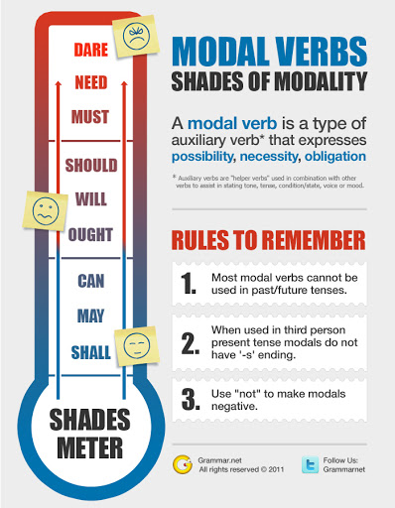

Slide 8
1. Types of (present) modal verbs
Modal verbs for deduction (Модални глаголи за носење логички заклучоци)
Can’t – That can’t be Tina, Tina is blond.
Must – You haven’t eaten all day so you must be tired.
May/Might – I am not sure where she is, she might be at work.
Modal verbs for ability (Модални глаголи за искажување способност)
Can – I can swim.
Can’t – My brother can’t swim
(Be) able to – I am not able to move my leg.
Could – Mia could run really fast when she was younger.

Slide 9
1. Types of modal verbs
Modal verbs for permission (Модални глаголи за барање дозвола)
Can – Can I borrow your pen?
May – May I go to the bathroom?
Could – Could you get me a glass of water, please?
Modal verbs for advice (Модални глаголи за давање совети)
Should – If you have a toothache, you should go to the doctor.
Shouldn’t – You shouldn’t eat so much candy, it is not healthy.
Ought to– I can’t help you with that. You ought to speak to the manager.
Modal verbs for necessity, obligation and prohibition (Модални глаголи за потреба, задолжителност и забрана)
Have to/Don’t have to – I don’t have to pay because this course is free.
Must – I must be on time, the rules in my school are strict.
Mustn’t– The law states that we mustn’t throw garbage in the national park.

Slide 10
1. Fill in the sentences using modal verbs (Sometimes, more than one answer is possible)
I ___________ speak Chinese: it's too difficult!
She ___________ take an umbrella; I think it's going to rain!
We ___________ take photos inside; it's forbidden.
You ____________ do more sport if you want to lose weight.
That __________ be Sarah’s mum – Sarah’s mum is in Germany.
You have been working all day long, you ___________ be tired.
Mrs. Connor, ________ I go to the bathroom?
Drivers _________ drive according to the speed limit.

Slide 11
2. Types of Perfect Modal verbs
Modal verbs for past deduction (Модални глаголи за носење логички заклучоци)
Can’t/Couldn’t have + past part. – That couldn’t have been Tina, Tina is blond.
Must have + past part.– You must have been so tired yesterday because you were working all day.
Modal verbs for ability and willingness in the past (Модални глаголи за искажување способност и желба да се направело нешто во минатото)
Could have + past part. – I could have helped you if you had asked me.
Would have + past part– I would have bought you a present if I had know it was your birthday.

Slide 12
2. Types of Perfect Modal verbs
Modal verbs for criticism of past actions (Модални глаголи за критикување на минатите дејства)
Should have + past part. – You should have started working out much sooner.
Shouldn’t have + past part. – You shouldn’t have eaten all that candy yesterday.
Modal verbs for possibility in the past (Модални глаголи за искажување можност во минатото)
May/Might have + past part. – Lea might have taken this photo.
Could have + past part.– He was there so he could have stolen the money, for all I know.

Slide 13
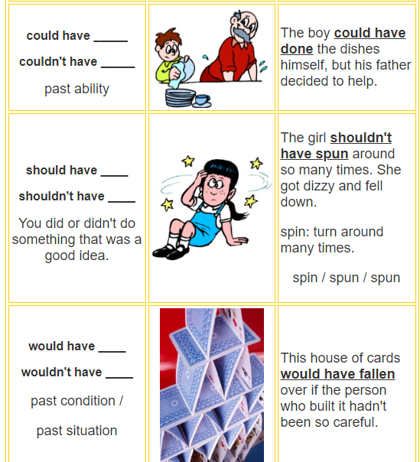
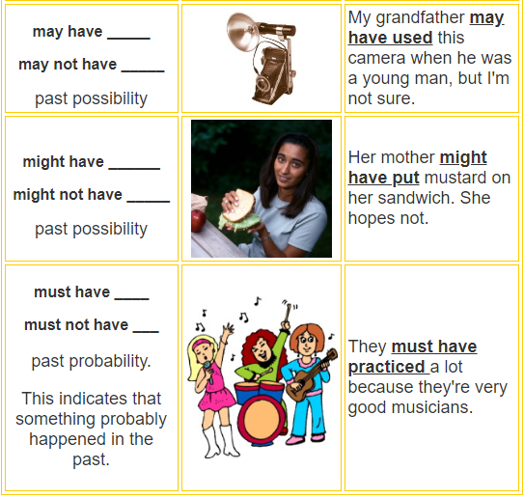

Slide 14
1. Fill in the sentences using perfect modal verbs (Sometimes, more than one answer is possible)
I ___________ (buy) bread if I had known we needed some.
We ____________(not/invite) so many people to our party! I'm worried that we won't have enough room for everyone!
You were right! I ____________ (start) saving money years ago!.
We ____________(join) you at the restaurant, but we couldn't get a babysitter.
The weather ____________(not/be) any worse! It was raining all day.
My mum ___________ (prepare) dinner last night – she does it every day.
I ______________(not/eat) so much chocolate after lunch! I feel sick now!

Slide 15
Need more help? Watch this video explaining Perfect Modal Verbs
https://www.youtube.com/watch?v=1PY6xIDkIj4
Or scroll though this PDF explaining Modals in general
https://www.uv.mx/personal/damorales/files/2013/01/modals-ilovepdf-compressed.pdf
Find more exercises at:
https://www.usingenglish.com/quizzes/398.html
https://www.english-grammar.at/online_exercises/modal-verbs/m008.htm

Slide 16
And remember: STAY HOME!

