Slide 1
Работна седмица 16-20 март 2020 год ОУ „Св. Климент Охридски“ –Битола англиски јазик VIII одд
Предметен настаник :
Виолета Поповска

Slide 2
Англиски јазик VIII одд Учебник: Messages-3 Наставна тема бр. 8 experiences
Present Perfect + FOR and SINCE

Slide 3
We use the present perfect tense with since and for to say how long an action has lasted.
We use the present perfect tense to talk about actions that started in the past and continue to the present. e.g. I’ve grown flowers for two years.
 Present perfect tense Since We use SINCE with the present perfect tense to refer to the starting point of an action.
e.g. I have studied at this school since 1997.
 Present perfect tense For
We use FOR with the present perfect tense to refer to a period of time.
e.g. I have studied at this school for five years.

Slide 5
Present perfect simple
How much do you know about London?
Since & For
Duration of Events

Slide 6
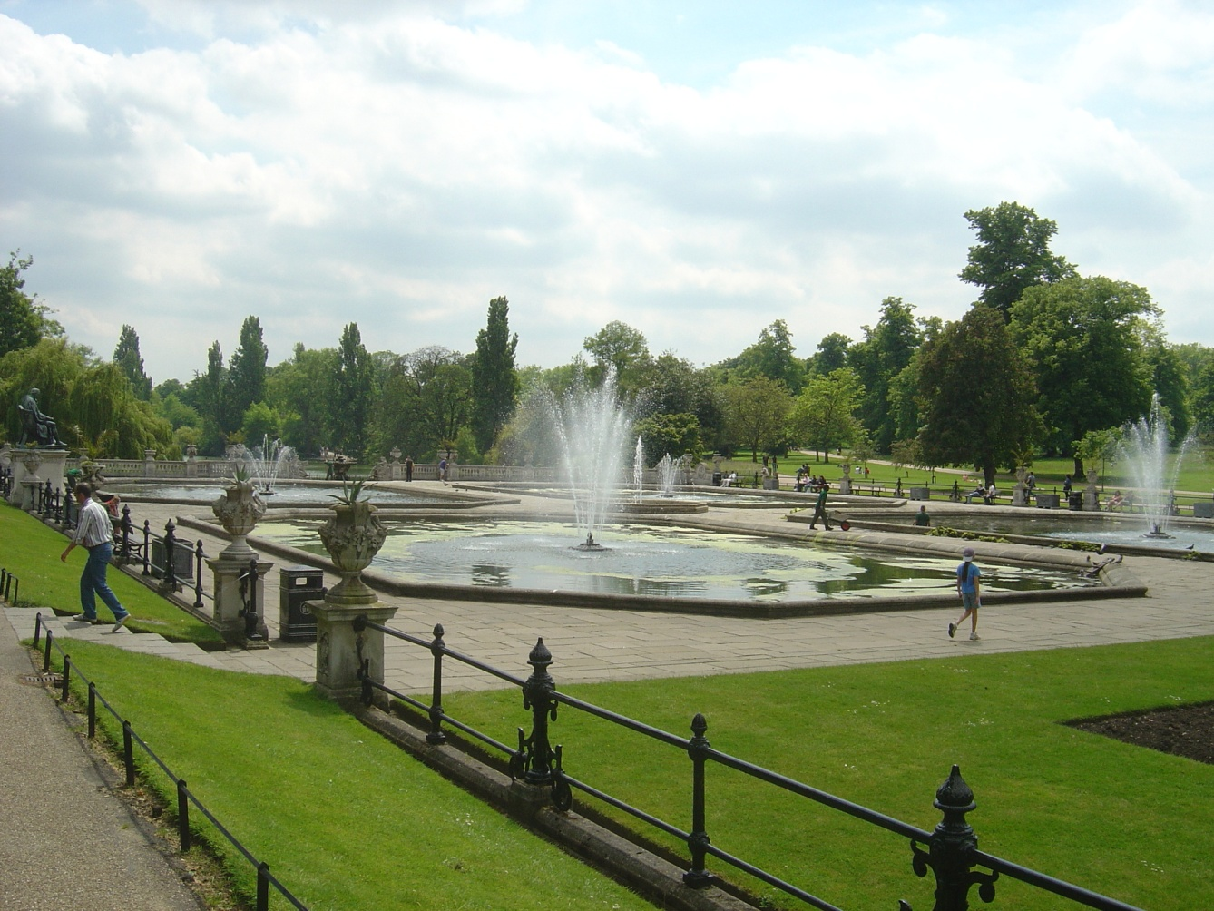
1637 .A long time
The Hyde Park has been opened to the general public SINCE 1637
The Hyde park has been opened to the general public FOR a long time.

Slide 7
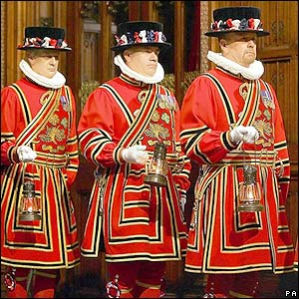
.The 1400S .Six centuries
The Beefeaters have been the guards of the Tower of London SINCE 1400.
The Beefeaters have been
the guards of the
Tower of
London FOR centuries.

Slide 8
The London Bridge has been in service SINCE 1894 The London Bridge has been in service FOR more than 100 years.
More than 100 years
In 1894

Slide 9
The British Royal Family have lived at the Buckingham Palace SINCE 1837. The British Royal Family have lived at the Buckingham Palace FOR nearly two hundred years.
Nearly two hundred years
1837

Slide 10
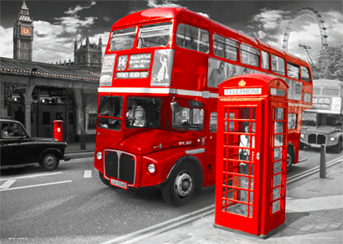
Double-decker buses have been used SINCE 1829. Double-decker buses have been used FOR more than 150 years.
1829
More than 150 years

Slide 11
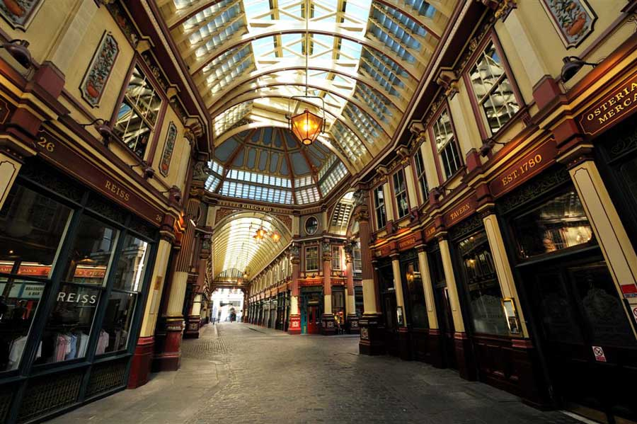
Shoppers have spent millions at Leadenhall
Market SINCE the 14th century. Shoppers have spent millions at Leadnhall Market FOR more than 500 years.
14th century
More than 500 years

Slide 12
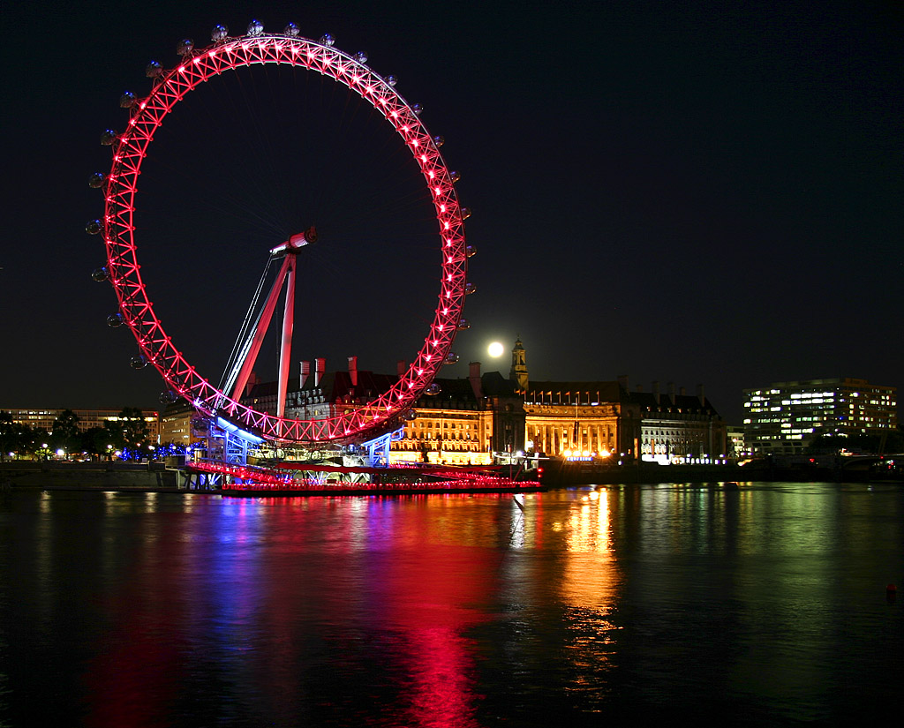
Tourists have taken a ride on the London Eye SINCE 2000. Tourists have taken a ride on the London Eye FOR more than 15 years.
2000
More than 15 years

Slide 13
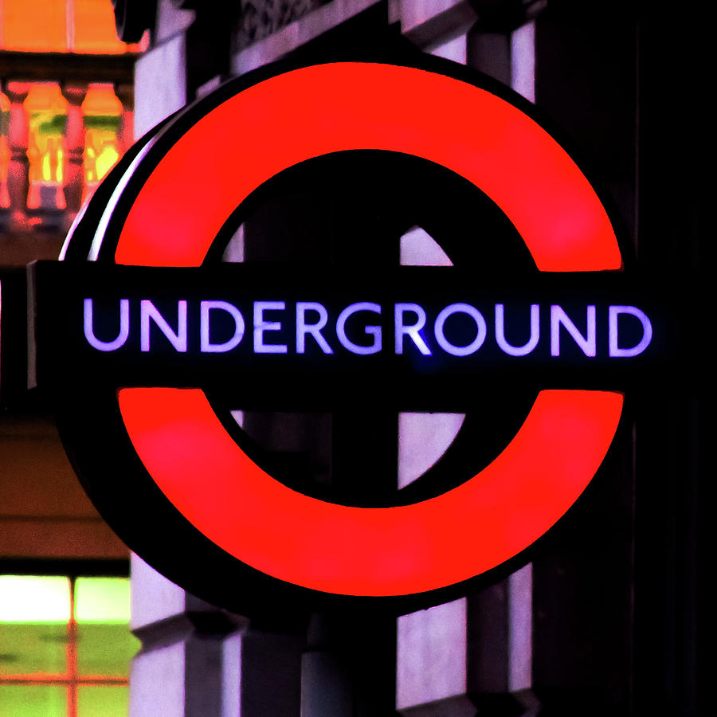
THERE has been an underground system in London SINCE 1863. THERE has been an underground system in London FOR more than 149 years.
1863
More than 149 years

Slide 14
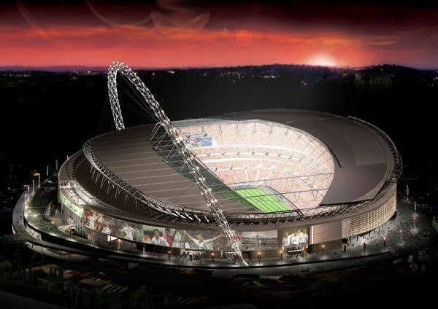
.2007 .A few years
Footballers have played in the new Wembley Stadium SINCE 2007.
Footballers have played in the new Wembley Stadium FOR a few years.

Slide 15
Fill in SINCE or FOR
1.He has been back ___________ two hours / __________ 3 o’clock.
2. I haven’t seen him _________ over two months / ________ Christmas.
3. You’ve been watching TV __________ you came home from school / _____ most of the evening.
4. Carol has been looking after the baby _________ this morning / ______ over four hours.
5. The Healers have had Dusty ________ their old dog died / ________ nearly two years.
6. We’ve been standing here ________ twenty-five minutes / _________ half past six.
7. Kate has been learning French ________ she was eleven / _________ four years.
8. Grandfather has lived with us ____________ Granny died / ________ quite some time.
Now you try

Slide 16
THANK YOU FOR YOUR TIME !

